Slide 1

A THI
To:
Human Resources Manager
Huynh Tan Phat, Hai Chau, Da Nang
Back-End Intern
Dear Hiring Manager,
My name is A Thi. I’m a second-year IT student at Passerelles Numériques Vietnam (PNV). My major is website programming. I tried to find your company on the internet because I knew about your company from people in my school who have interned in your company and I know your company has a lot of training sessions, people are friendly and enthusiastic. And I'm writing to express my huge interest in the Back-End intern position. The time I can intern as prescribed at my school is 2 months. From 10/07/2023 to 03/09/2023. I strongly believe that My training, experience, and abilities make me confident to apply for this internship at your company.
During the two years of studying here, I have learned some courses in Databases, Algorithms and Data structures, Object-Oriented Programming, and Java. I have been studying some languages to design websites such as HTML, CSS, and JavaScript and I have some projects with that language such as SELL PRODUCT WEB individual projects and BOOKING DOCTOR projects using JavaScript, HTML-CSS and there are more. I'm sure with that knowledge and the ambition to self-develop, I will be a perfect intern in your company.
I was also intensively trained in essential soft skills and English. Thanks to the professional skills that the teachers taught, I am more confident and have different skills like time management, teamwork, and plan-making. Moreover, my English skills have improved efficiency.
I know your company is one of the most beautiful and comfortable working places among the IT community in Viet Nam, so I believe that I can learn many new things from your company.
I look forward to having an opportunity to further discuss my application with you and how I can significantly contribute to the ongoing development of your company. Please consider the enclosed CV for more information about my education and experience. Should you inquire about any additional information about my application, please contact me at 0355279217 or email me at thi.a24@student.passerellesnumeriques.org.
Thank you for your time in considering my application. I am looking forward to receiving a positive response from you.
Best regards,
A Thi

Slide 2
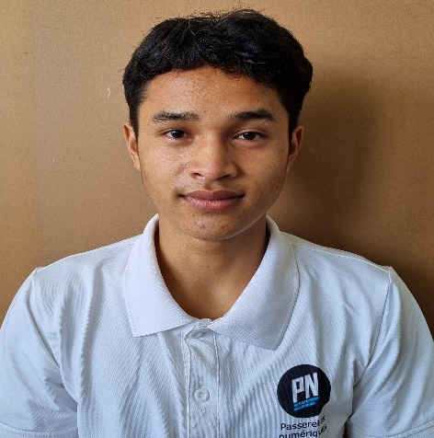



A THI
0355 279 217
thi.a24@student.
Passerellesnumeriques.org
Back-End Intern
101B, Le Huu Trac, Phuoc My, Son Tra, Da Nang
SOFT SKILLS
EDUCATION
Researching
Teamwork
Communication
Problem-Solving
PASSERELLES NUMERIQUES VIETNAM
Bachelor in Information Technology
Oct 2021 – Oct 2024
PROJECT
TECHNICAL SKILLS
DOCTOR BOOKING WEB Jan 2023
HTML, CSS, JavaScript, GitHub
Linking Mock API, JSON-Server to get Data
Designing validation for form
Designing admin’s interface
Developing main functions: display, search, add
and delete the user’s information
Storaging code using GitHub
HTML & CSS
JavaScript
PHP
MySQL
LANGUAGE
Vietnamese
English
COSMETICS SELL WEBSITE Nov 2022 – Dec 2022
Visual Studio Code - HTML, CSS, Bootstrap
Following the available website
Analyzing how to do and code
Presentation
ACTIVITIES
Giving Gifts
Nov 2022
Team member
Conduct street sales to earn money to buy gifts
Presenting project
RESTAURANT MANAGEMENT Oct 2022 – Nov 2022
Workbench – MySQL
Designing a database
Reading project requirements
Creating tables and making relationships and creating queries
Presentation about project
INTERESTS
REFERENCE
Analyzing
Drinking coffee
Vo Cong Dinh IT Trainer
0905 729 707
dinh.cong@passerellesnumeriques.org

